Slide 1


Electric Circuits
Twelfth Edition, Global Edition
Chapter 4 – Part 8
Techniques of Circuit Analysis
© 2024 Pearson Education Ltd. All Rights Reserved.
Notes:
If this PowerPoint presentation contains mathematical equations, you may need to check that your computer has the following installed:
1) Math Type Plugin
2) Math Player (free versions available)
3) NVDA Reader (free versions available)

Slide 2
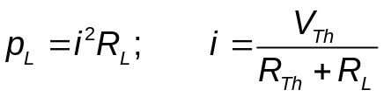
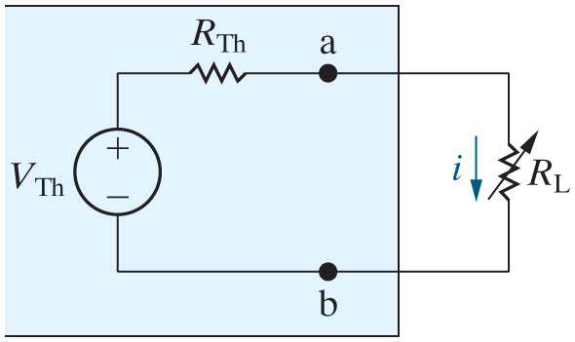
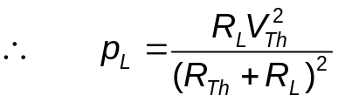
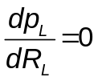
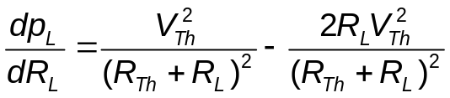
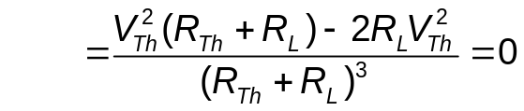

Chapter 4 – techniques of circuit analysis (1 of 16)
Condition for maximum power transfer
  Suppose we can vary the load resistance. For what value of load resistance will maximum power be absorbed by the load?
For max. power,
Represents the Thevenin equivalent of an arbitrary subcircuit that will not change
Represents a variable load
Notes:
Long Description 1:
Start Fraction d p subscript L BaseLine over d R subscript L BaseLine End Fraction equals Start Fraction V subscript T h BaseLine squared over Open Parenthesis R subscript T h BaseLine plus R subscript L BaseLine Close Parenthesis squared End Fraction minus Start Fraction 2 R subscript L BaseLine V subscript T h BaseLine squared over Open Parenthesis R subscript T h BaseLine plus R subscript L BaseLine Close Parenthesis squared End Fraction.
Long Description 2:
Equals Start Fraction V subscript T h BaseLine squared Open Parenthesis R subscript T h BaseLine plus R subscript L BaseLine Close Parenthesis minus 2 R subscript L BaseLine V subscript T h BaseLine squared over Open Parenthesis R subscript T h BaseLine plus R subscript L BaseLine Close Parenthesis cubed End Fraction equals 0.

Slide 3
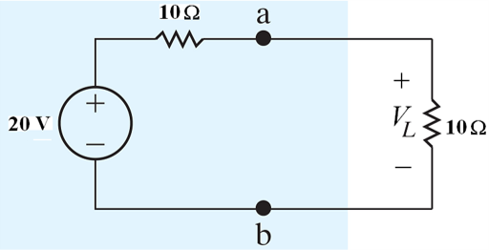
Chapter 4 – techniques of circuit analysis (2 of 16)
In the circuit below, the load resistor is matched to the Thevenin resistance – how much voltage drops across the load resistor?
A. 20 V
B. 10 V
C. 5 V
D. 40 V

Slide 4


Chapter 4 – techniques of circuit analysis (2 of 16)
In the circuit below, the load resistor is matched to the Thevenin resistance – how much voltage drops across the load resistor?
A. 20 V
B. 10 V
C. 5 V
D. 40 V

Slide 5
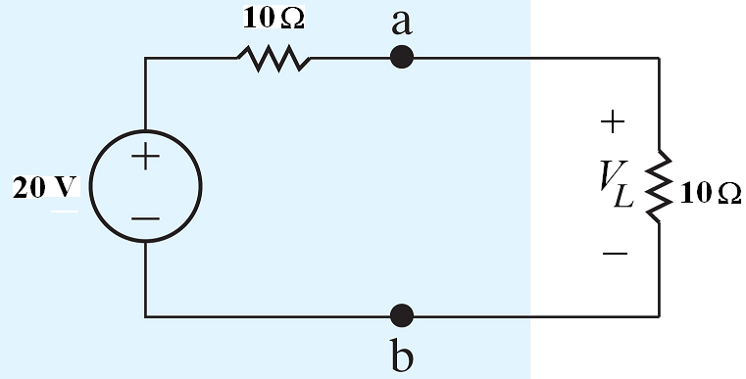
Chapter 4 – techniques of circuit analysis (3 of 16)
In the circuit below, the load resistor is matched to the Thevenin resistance – how much power is absorbed by the load resistor?
A. 100 W
B. 50 W
C. 20 W
D. 10 W

Slide 6
Chapter 4 – techniques of circuit analysis (3 of 16)
In the circuit below, the load resistor is matched to the Thevenin resistance – how much power is absorbed by the load resistor?
A. 100 W
B. 50 W
C. 20 W
D. 10 W

Slide 7
Chapter 4 – techniques of circuit analysis (4 of 16)
In the circuit below, the load resistor is matched to the Thevenin resistance – how much power is delivered by the voltage source?
A. 100 W
B. 50 W
C. 20 W
D. 10 W

Slide 8
Chapter 4 – techniques of circuit analysis (4 of 16)
In the circuit below, the load resistor is matched to the Thevenin resistance – how much power is delivered by the voltage source?
A. 100 W
B. 50 W
C. 20 W
D. 10 W

Slide 9
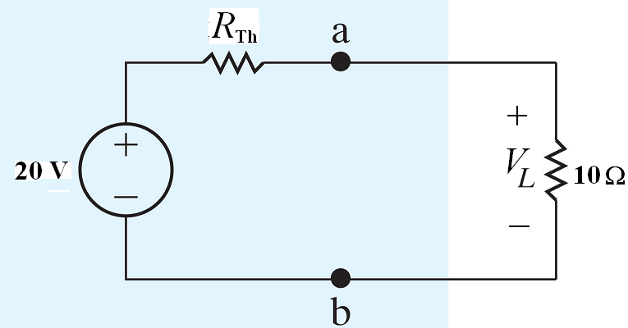



Chapter 4 – techniques of circuit analysis (5 of 16)
Suppose that we vary the Thevenin resistor instead of the load resistor. For what value of Thevenin resistance is maximum power delivered to the load resistance?
A.
B.
C.
D. None of the above

Slide 10
Chapter 4 – techniques of circuit analysis (5 of 16)
Suppose that we vary the Thevenin resistor instead of the load resistor. For what value of Thevenin resistance is maximum power delivered to the load resistance?
A.
B.
C.
D. None of the above

Slide 11
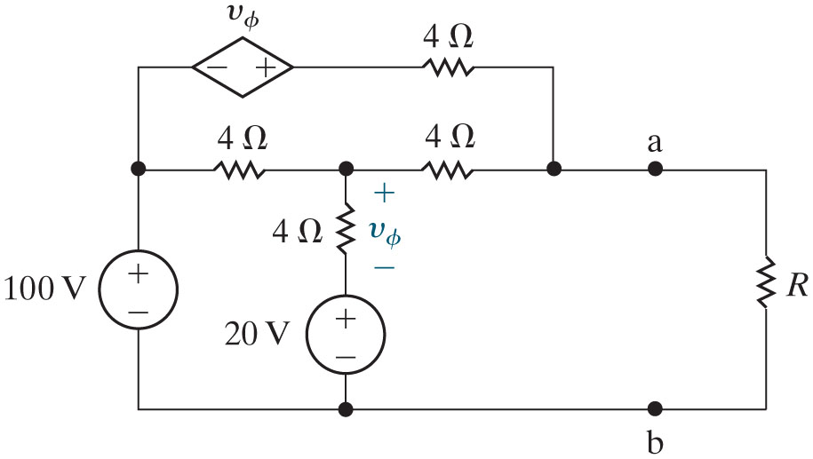
Chapter 4 – techniques of circuit analysis (6 of 16)
Example of maximum power transfer
  Find the value of R such that maximum power is transferred to R, and find that maximum power.
Approach – find the open circuit and the short circuit current by analyzing two circuits – see the next slides.

Slide 12
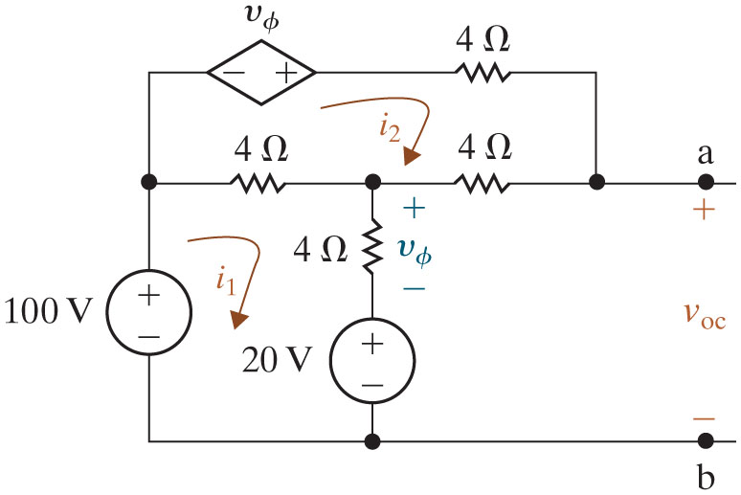






Chapter 4 – techniques of circuit analysis (7 of 16)
Find the value of R such that maximum power is transferred to R, and find that maximum power.
  Find the open circuit voltage:
mesh:
mesh:
One 4i₂ is missing in the equation. (Thanks to Alper for pointing it out.)
constraint:
Solving:

Slide 13
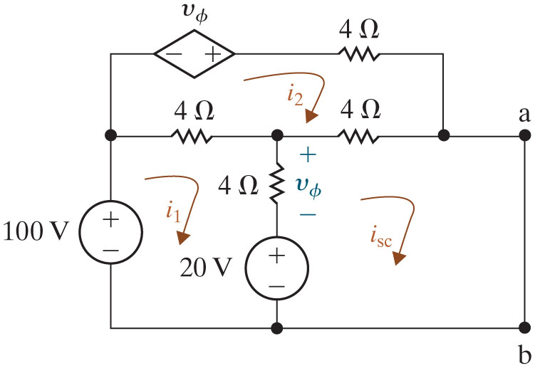






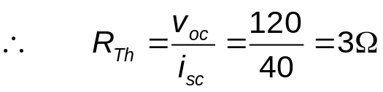
Chapter 4 – techniques of circuit analysis (8 of 16)
Find the value of R such that maximum power is transferred to R, and find that maximum power.
  Find the short circuit current:
mesh:
mesh:
mesh:
constraint:
Solving:

Slide 14
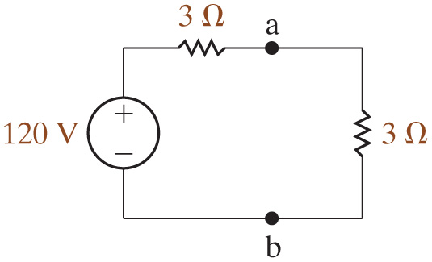
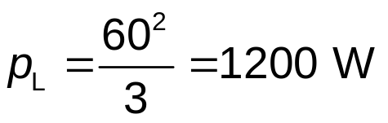
Chapter 4 – techniques of circuit analysis (9 of 16)
Find the value of R such that maximum power is transferred to R, and find that maximum power.
  The Thevenin equivalent:

Slide 15

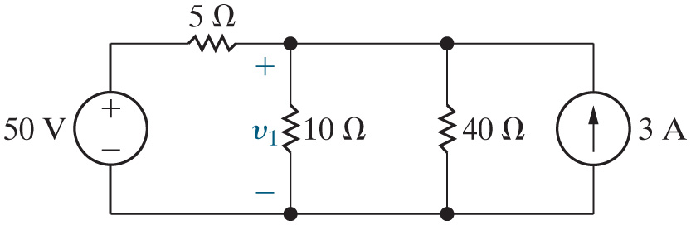
Chapter 4 – techniques of circuit analysis (10 of 16)
Linear circuits, which are examples of linear systems, obey the property of superposition. Thus, when a linear circuit has more than one independent source, we can find that circuit’s response by summing the responses to each source independently.
Use superposition to find the voltage
in the circuit here.

Slide 16

Chapter 4 – techniques of circuit analysis (11 of 16)
We begin by calculating the voltage across the
resistor
due to the voltage source. We need to set the value of the current source to 0 A. Therefore, we replace the current source with a(n)
A. open circuit
B. short circuit
C. voltage source
D. dependent source

Slide 17
Chapter 4 – techniques of circuit analysis (11 of 16)
We begin by calculating the voltage across the
resistor
due to the voltage source. We need to set the value of the current source to 0 A. Therefore, we replace the current source with a(n)
A. open circuit
B. short circuit
C. voltage source
D. dependent source

Slide 18

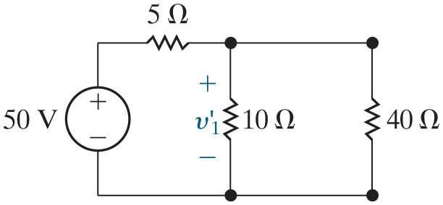


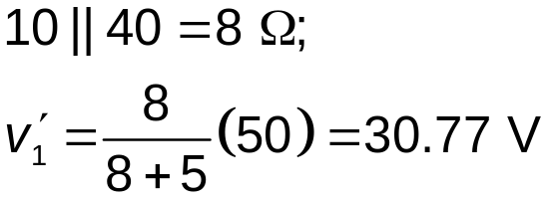
Chapter 4 – techniques of circuit analysis (12 of 16)
Use superposition to find the voltage
in the circuit here.
  Calculate the response
to the voltage source:
Combine the
and
resistors into a single equivalent
resistor. Then use voltage division to find

Slide 19
Chapter 4 – techniques of circuit analysis (13 of 16)
Now we calculate the voltage across the
resistor due to
the current source. We need to set the value of the voltage source to 0 V. Therefore, we replace the voltage source with a(n)
A. open circuit
B. short circuit
C. voltage source
D. dependent source

Slide 20


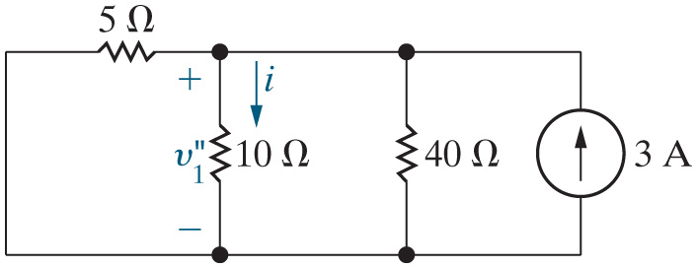

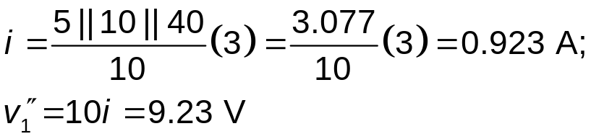
Chapter 4 – techniques of circuit analysis (14 of 16)
Use superposition to find the voltage
in the circuit here.
  Calculate the response
to the current source:
Use current division to find the current i in the
resistor.
Then use Ohm’s law to find
Notes:
Long Description:
i equals Start Fraction 5 parallel to 10 parallel to 40 over 10 End Fraction Open Parenthesis 3 Close Parenthesis equals 3.077 divided by 10 Open Parenthesis 3 Close Parenthesis equals 0.923 Amperes;
v subscript 1 BaseLine double prime equals 10 i equals 9.23 Volts.

Slide 21

Chapter 4 – techniques of circuit analysis (15 of 16)
Use superposition to find the voltage
in the circuit here.
Finally, sum the responses to each source independently to get the total response.

Slide 22
Chapter 4 – techniques of circuit analysis (16 of 16)
Summary of circuit analysis techniques:
Ohm’s Law
K V L and K C L
Combining resistors in series and parallel
Voltage division and current division
Node voltage method
Mesh current method
Source transformation
Thevenin and Norton equivalents
Superposition

Slide 23

Copyright
This work is protected by United Kingdom copyright laws and is provided solely for the use of instructors in teaching their courses and assessing student learning. Dissemination or sale of any part of this work (including on the World Wide Web) will destroy the integrity of the work and is not permitted. The work and materials from it should never be made available to students except by instructors using the accompanying text in their classes. All recipients of this work are expected to abide by these restrictions and to honor the intended pedagogical purposes and the needs of other instructors who rely on these materials.

